Slide 1


STORES KEEPER: SCAN TO TOKENIZE
An inventory management solution for British Airways Engineering and beyond.
June 2023

Slide 2


BIO
Current​
British Airways 2022 - Present​
Duty Maintenance Manager - JFK NY, US
Graduate - Aviation Management Executive MSc at University of London, City
“Stores Keeper originated from my MSc project, which concluded in May 2024. It is now implemented at JFK, with plans for expansion across North America and beyond. By leveraging a QR-code scanning mobile app with blockchain integration, we are equipping our team with the tools they need to streamline operations, enhance accuracy, ensure traceability, and significantly reduce costs.”

Slide 3
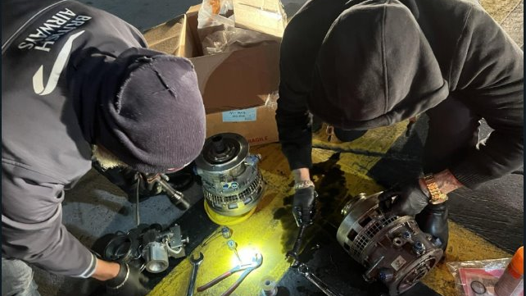
- $1M AOG
In September 2023 at JFK, a CF6 starter unit was incorrectly cataloged, delays in obtaining it led to a $1 million Aircraft On Ground (AOG) situation​​​​. Situation such as these are recurrent.

Slide 4

Current Challenges in Inventory Management
1. Lack of Traceability and Accountability:
Inventory data is manually entered.
No error-checking systems are in place.
Updating the database is time-consuming.
2. Inefficiencies in Part Retrieval:
Incorrect records lead to lengthy part-retrieval.
Aircraft downtime is extended, disrupting operations.
Part records and documentation are separated, risking integrity.
3. Absence of Monitoring and Predictive Stock Keeping:
Inventory records are difficult to access and search.
Maintenance managers do not rely on data to predict needs.
Illustrative

Slide 5
"Empowering staff with the necessary tools is the central aim of Stores Keeper. By implementing an advanced inventory management solution, such as a user-friendly mobile app with blockchain integration, we seamlessly enable our team to significantly enhance efficiency, accuracy, and accountability in their operations, while achieving substantial cost savings.

Slide 6
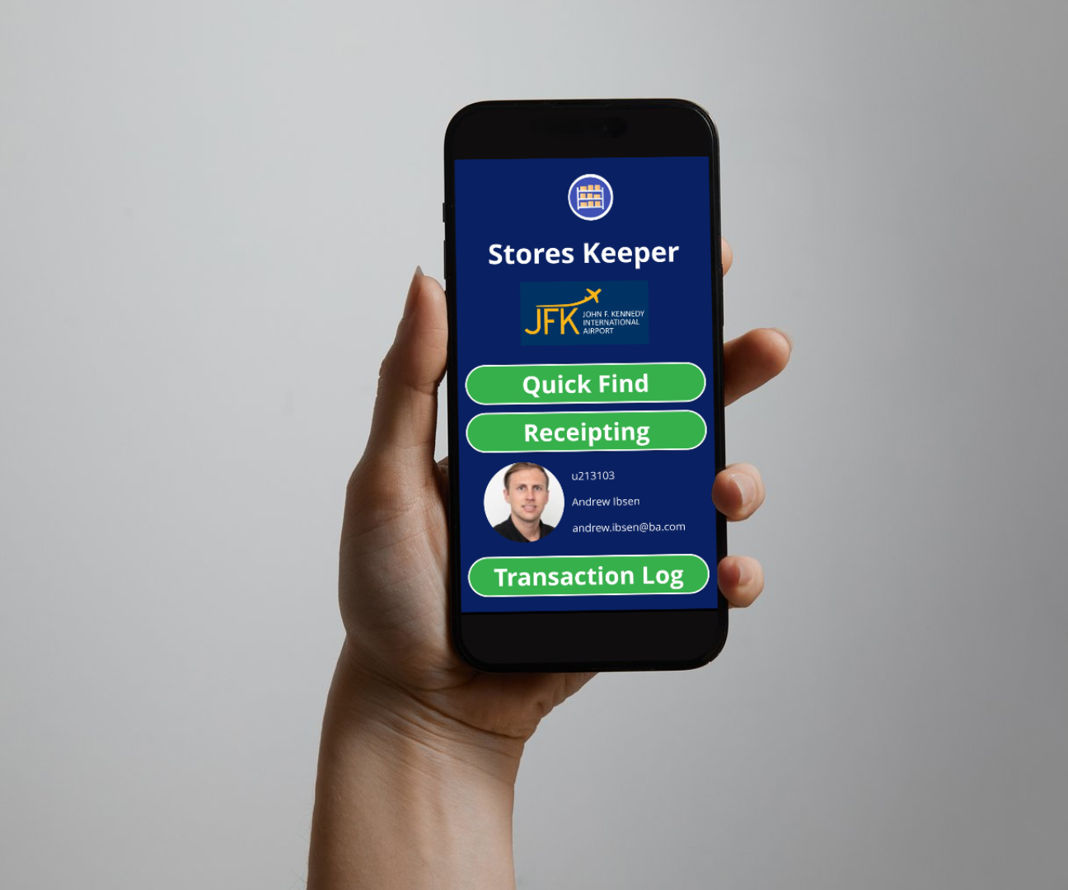
What is Stores Keeper?
Accurate, tamper-proof inventory records, backed onto a distributed ledger
Immutable part documentation records
User friendly, no-code mobile interface for easy check-in and check-out of parts using barcode scanning, for all maintenance employees
Accurate automated alert system to prevent low stocks of essentials which could delay operations
Real-time customizable dashboards to keep track of stocks, costs and efficiency of stores.

Slide 7
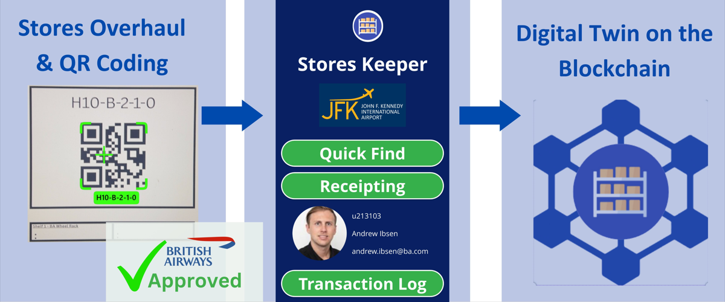
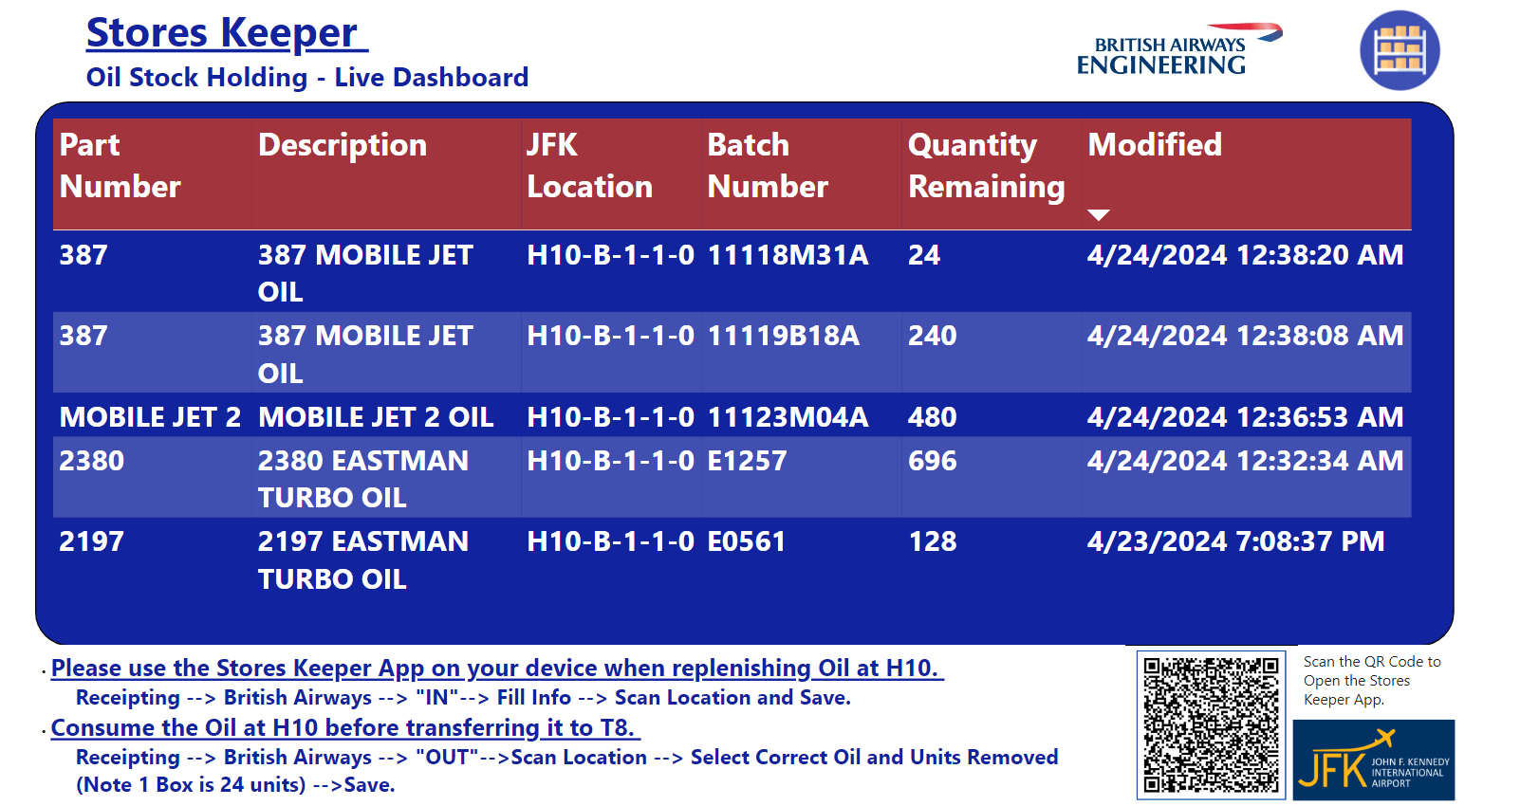
Blockchain made Simple
Live Dashboards with Automated Alerts
Make informed decisions using the right data at the right time.

Slide 8

Stores Keeper Impact
After only 3 weeks of use in JFK, Stores Keeper:
Eliminated data entry errors by all maintenance employees.
Reduced transaction-time by 30%.
Saved 150K by identifying misplaced and mislabeled parts.
Since its deployment in February 2024:
30/30 BA JFK Maintenance Employees use Stores Keeper daily.
No misplaced or mislabeled parts have delayed maintenance.
12 managers have customized dashboards and automated alerts.
BA Quality is currently making it a local working procedure.

Slide 9
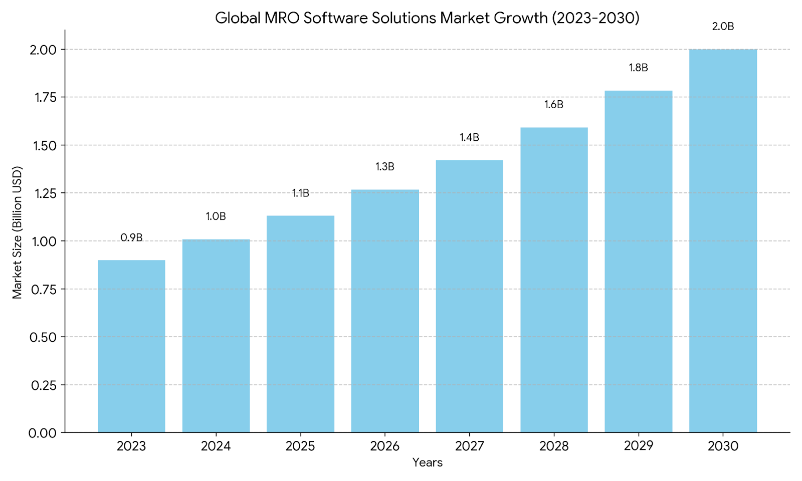
How big is this global market?
The global MRO (Maintenance, Repair, and Overhaul) software solutions market is experiencing significant growth. As of 2024, the digital MRO market is estimated to be valued at approximately USD 1 billion and is projected to reach USD 2.0 billion by 2030, growing at a compound annual growth rate (CAGR) of 13.0%

Slide 10
“As we look to expand this project across North America and beyond, we are excited about the opportunities for further innovation and improvement. We invite you to join us in this journey, provide your valuable feedback, and support our efforts to transform inventory management.”

